Slide 1
Dynamic CSS
Tutorial #11

Slide 2
OBJECTIVE

Slide 3
Objective
This tutorial explains how to manipulate CSS properties using Javascript.

Slide 4
TEXTPLANATION

Slide 5
Textplanation
Blather.

Slide 6
Textplanation
Static and dynamic are two terms that computer programmers like to throw around a lot.

Slide 7
Textplanation
When something is static, it never changes. You can forever depend on it to be exactly the same every time you run your page. It’s boring.

Slide 8
Textplanation
When something is dynamic, it is adjustable on the fly. That means that your end user can make meaningful decisions and your code can react to those decisions. It’s exhilarating.

Slide 9
Textplanation
If we can make variables dynamic in that their values change at the click of a button or as a function of some other part of your program, why can't we do the same with CSS?

Slide 10
Textplanation
Well, of course, we can.

Slide 11
Textplanation
Each HTML object has a property called style. It, itself, is an object and it has hundreds of properties of its own. Each of those properties corresponds to a CSS property. Once you learn how to mess with their values, you have dynamic CSS.

Slide 12
CONSTRUCTION

Slide 13
Construction
Create a folder somewhere on your drive and label it Dynamic CSS.
Open up notepad++.
Save the empty file to your folder and name the file “index.html”.
All first pages on a website are called index.
As you go through the images of the construction, add to your code. You will see comments with explanations of what you are doing. Those comments will change with each slide. You should not type my comments into your code.

Slide 14
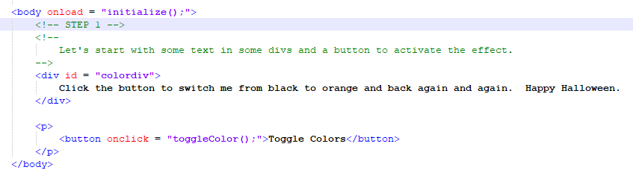
Construction

Slide 15
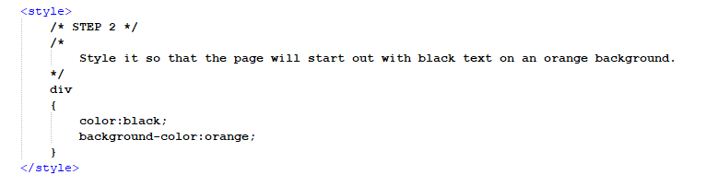
Construction

Slide 16
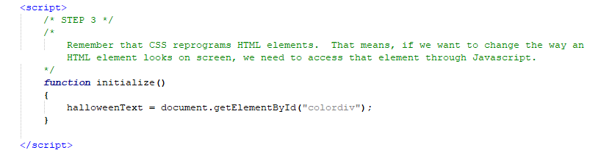
Construction

Slide 17
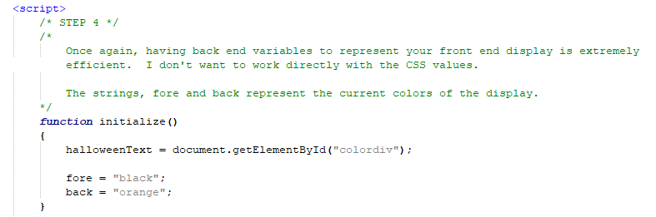
Construction

Slide 18
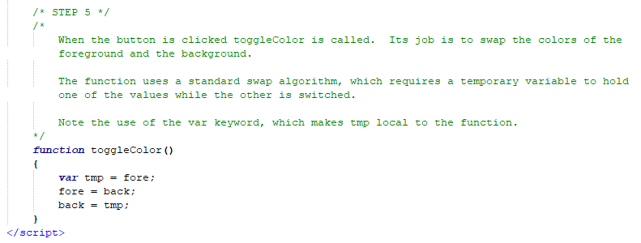
Construction

Slide 19
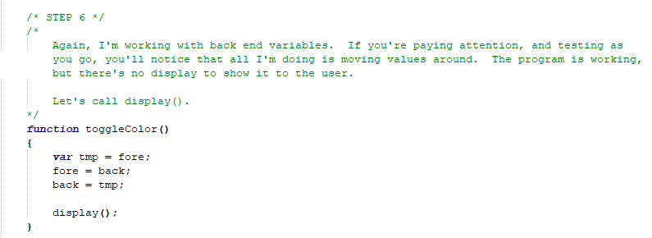
Construction

Slide 20
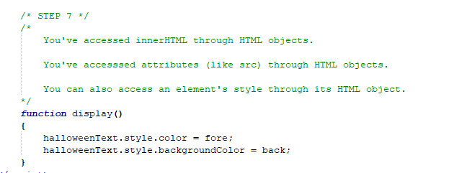
Construction

Slide 21
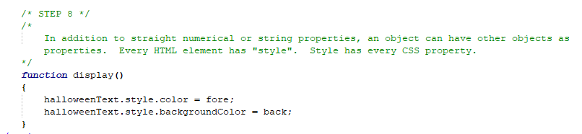
Construction

Slide 22
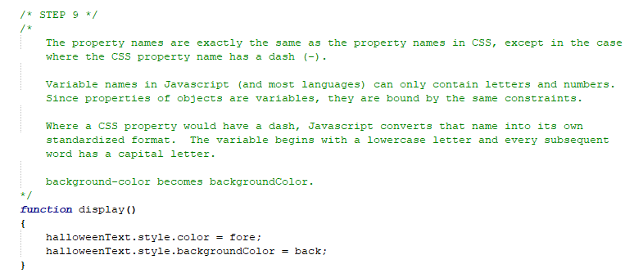
Construction

Slide 23
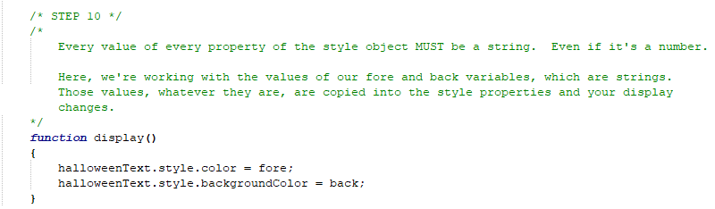
Construction

Slide 24
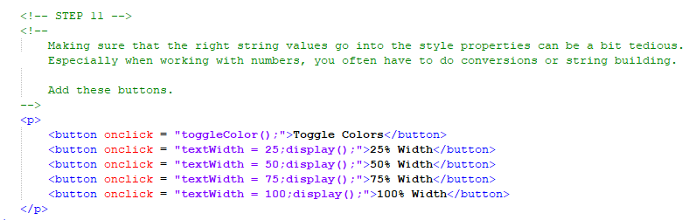
Construction

Slide 25
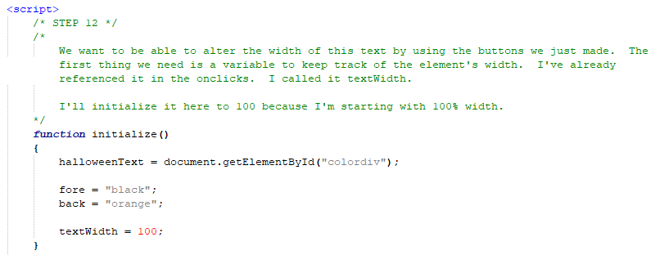
Construction

Slide 26
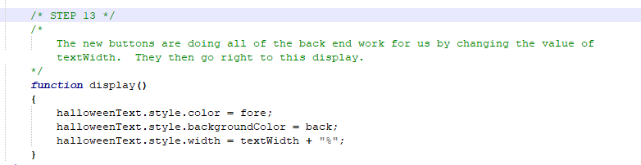
Construction

Slide 27
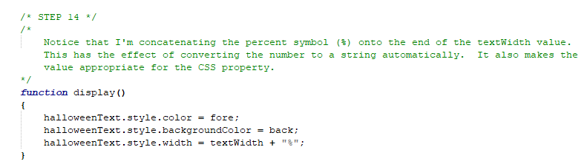
Construction

Slide 28
A DEEPER MEANING

Slide 29
A Deeper Meaning
Strings are everything in web programming. Absolutely every CSS property value comes in the form of a string. Even the numbers. When you manipulate them in Javascript, you must record them as strings, either with variables or by using quotes.

Slide 30
A Deeper Meaning
Because of this, having back end variables is extremely important. Let’s say you want to manipulate the color of something and you’re working with RGB values. Those are decimal numbers (0 to 255), but the property value looks like, “rgb(123, 123, 123)”. If I want to add, subtract, or perform some other arithmetic operation on the amount of red in the color, I can’t do that with the string. I’d need to extract the red value from the string, convert it to a number, perform my operation, and then put it back into the string.

Slide 31
A Deeper Meaning
That’s a lot of unnecessary work.

Slide 32
A Deeper Meaning
If I have 3 variables, one for red, one for blue, and one for green, I can update those values on the fly and then use concatenation to build an rgb string.

Slide 33
A Deeper Meaning
Whenever you manipulate CSS through Javascript, you will encounter this issue. Some values automatically convert to strings on the fly. Others need some nudging.

Slide 34
A Deeper Meaning
Practice makes perfect.

Slide 35
FAQ

Slide 36
FAQ
What do I do if I have a string value and I want to convert it to a number?
Javascript has a built in function called parseInt. That function takes in a string, and returns the leading digits as numbers. For example, if you call parseInt(“123”), you’ll get back the number 123. If you call parseInt(“123contact”), you’ll still get back the number 123. If you try to use parseInt without a leading number, you’ll get back NaN, which means, Not a Number.

Slide 37
ACTIVITY

Slide 38
Dynamic Color Change
Create a page that allows the user to change the background color by adjusting the values of red, green, and blue.
Create +1. -1. +5, -5, +10, and – 10 buttons for each of the three colors.
Keep track of the values of red, green, and blue, limiting them to numbers between 0 and 255.

Slide 39
Dynamic Color Change
Each time the user clicks on one of the buttons, one of the values will change.
Display the proper background color by setting the property to the proper value rgb(r, g, b).

Slide 40
Dynamic Color Change
This activity requires string building.
You will be keeping track of your values individually and you will need to put them all together in a string that looks like:
rgb(r, g, b)
Where r, g, and b are the decimal values of each color red, green, and blue.

